Slide 1
Prepare for Impact !
3 Key Questions about RDA for Every Special Education Administrator
W. Alan Coulter, Ph.D. Human Development Center, LSUHSC New Orleans, LA
Notes:
Steve
What a Line Up ! – Randy Sprick, Bob Pasternack, Doug Fuchs…

Slide 2
Thanks So Much
What a Privilege to be Have a Conversation with You
Notes:
I’m a recovering Compliance Monitor – trying to be positive…

Slide 3
Why ?

Slide 4
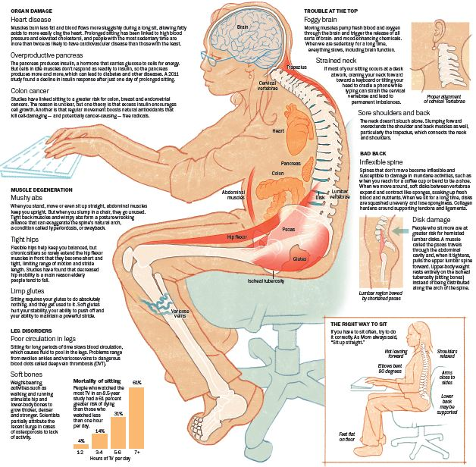
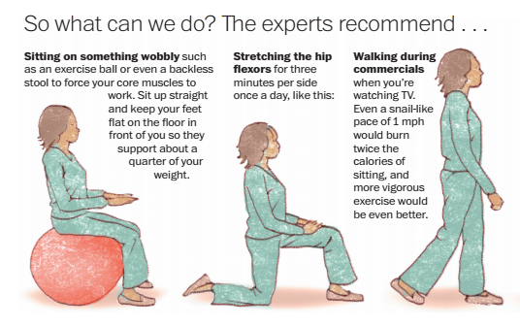
Don’t Just Sit There

Slide 5
Our Purpose Today
What You Need to Know about Changes w/RDA & the Potential Impact on You !

Slide 6
Disclaimer
Alan is Not OSEP !
Adaptations were made from OSEP & other materials…

Slide 7
How Did We Get Here ?
Context for RDA

Slide 8
39 Years of Special Education Law
Four Original Purposes of the Law
FAPE
Protect Rights
Provide Technical Assistance, and

Slide 9
39 Years of Special Education Law
Four Original Purposes of the Law
to assess and assure the effectiveness of efforts to educate all children with disabilities”
a.k.a. – Accountability !

Slide 10
Monitoring Compliance
1978 - “The Office of Education will be looking at 6,000 to 7,000 IEPs in the next few months to see whether any problems are developing” Ernest Boyer, 1979, p. 300.
IEP = Compliance
Notes:
Source: Boyer, E. (1979, February). Public Law 94-142: A promising start. Educational Leadership.

Slide 11
Never Forget
There are More than 755+ Process Requirements in IDEA ’04 Regulations.

Slide 12
A Checklist Mentality
The Checkmark is NOT the Result !

Slide 13
Going to NonCompliance Jail?
Corrective Actions ?
Settlement Agreements ?
Independent Monitors ?

Slide 14
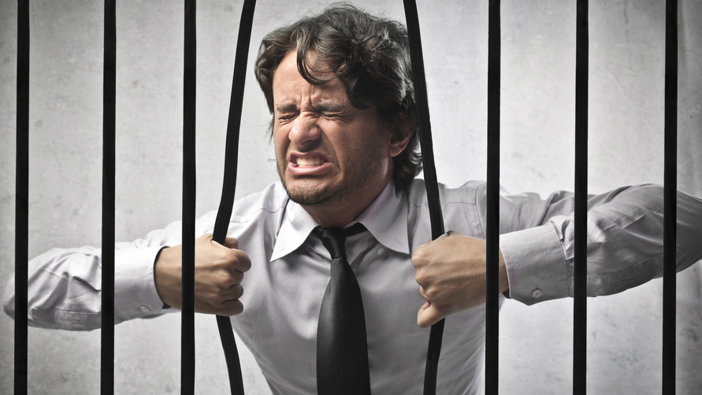
I Should Have Checked that IEP More Carefully

Slide 15
Historic Focus
Procedural Compliance
Student Learning Outcomes

Slide 16
How Do We Know Special Education is Effective ?

Slide 17
Part B: SPP Compliance Indicators
Indicator
9: | Disproportionate Representation
10: | Disproportionate Representation
11: | Child Find
12: | Early Childhood Transition
13: | Secondary Transition
15: | Compliance Findings
20: | Timely and Accurate Data
These are the Basis of State Status Determinations (up to 2014)
Notes:
17

Slide 18
Part B: SPP Results Indicators
Indicator
1: | Graduation
2: | Drop out
3: | Statewide Assessment
4: | Suspension and Expulsion
5: | Educational Environments
6: | Preschool Educational Environments
7: | Preschool Outcomes
8: | Parent Involvement
14: | Postsecondary Outcomes
18: | Resolution Session Agreements
19: | Mediated Agreements
Not Counted Towards Determination of Compliance
Notes:
18

Slide 19
2007 U.S. Dept of Education Determinations on State Implementation of IDEA Part B Determinations
American Samoa
Guam
Times Have Changed
Northern Marianas
D.C.
Palau
Puerto Rico
Marshall Islands
B.I.A.
Micronesia
Meets Requirements
V.I.
Needs Assistance
Needs Intervention
Source: www.ed.gov
Notes:
www.ed.gov/policy/speced/guid/idea/monitor/factsheet.html

Slide 20
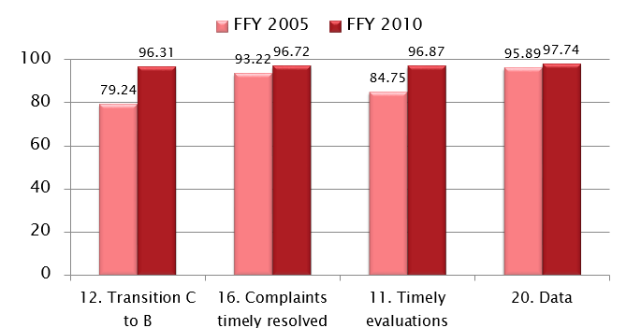
States Aggregate Performance on Selected Compliance Indicators
Adapted from OSEP presentation
Data Source: OSEP

Slide 22
Success Was Being Realized

Slide 23
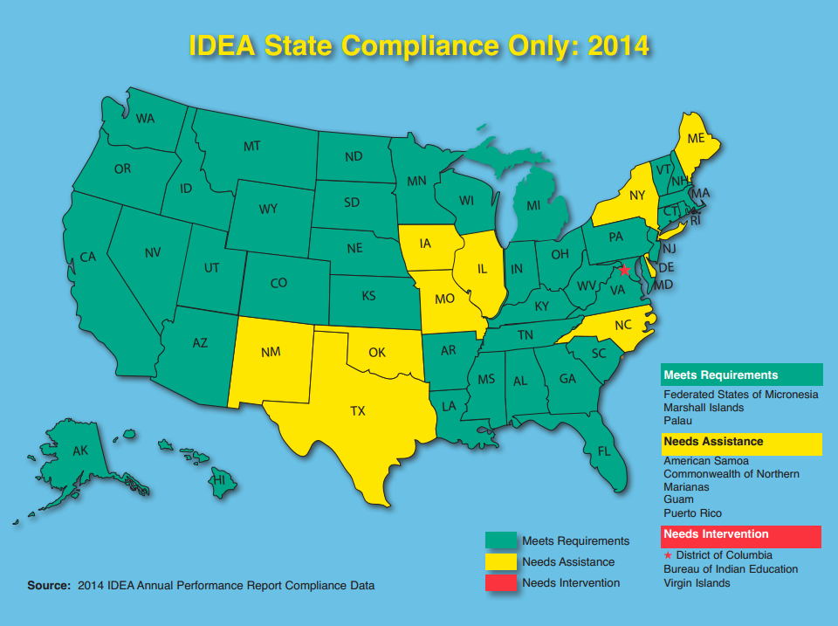
What Could Have Been in 2014 Before RDA
Data Source: OSEP

Slide 24
Never Forget
There are more than 755 Process Requirements in IDEA ’04 Regulations.
And even if You could be in Compliance with All 755, You would have No Assurance of Results

Slide 25
What’s Missing
Time for a Shift

Slide 26
The Shift in Accountability
“For too long we’ve been a compliance-driven bureaucracy when it come to educating students with disabilities,” said U.S. Secretary of Education, Arne Duncan.
Adapted from OSEP presentation

Slide 27
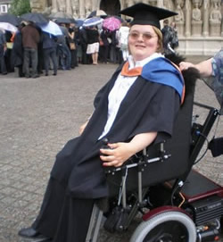
The Emphasis of I.D.E.A.
“…Our national policy of ensuring equality of opportunity, full participation, independent living, and economic self-sufficiency for individuals with disabilities”

Slide 28
The Primary Focus of Federal and State Monitoring activities shall be on –
Improving Educational RESULTS and Functional OUTCOMES for all children with disabilities
Ensuring that States meet… the program requirements, with… emphasis on those most related to Improving Results
20 U.S.C. 1416(a)(2)
+
Adapted from OSEP presentation

Slide 29
Percentage of public school students with a 'proficient' score, National Assessment of Educational Progress, 2013
 | Students w/IEPs |  | Other students
 | reading | math | reading | math
4th grade | 9 | 16 | 37 | 45
8th grade | 6 | 7 | 37 | 38
12th grade | 8 | 4 | 39 | 26

Slide 30
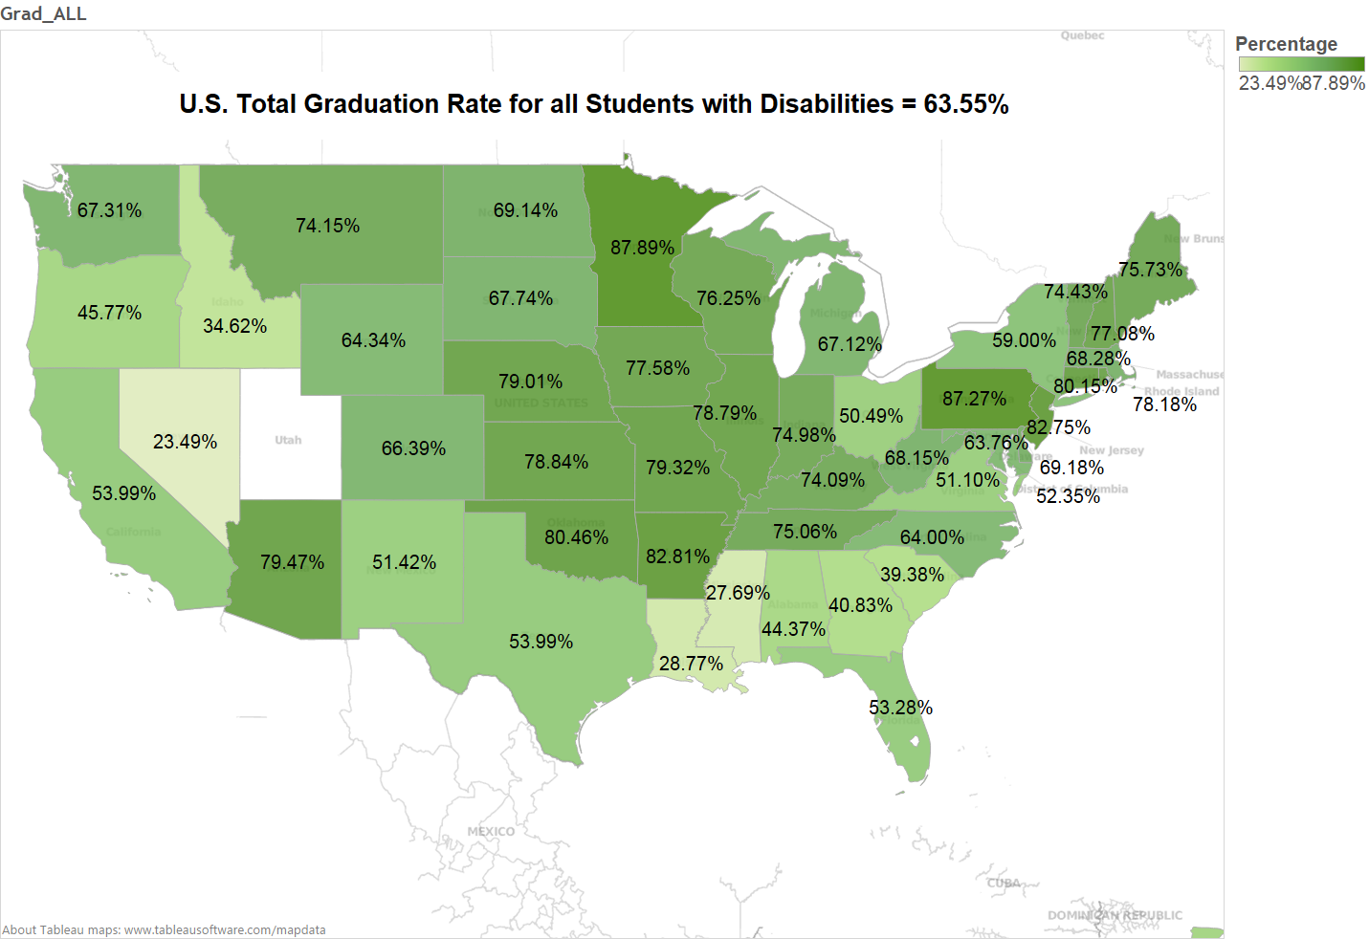
Range 87.9% to 23.5%
Data Source: OSEP

Slide 31
High School Graduation with a Regular Diploma.
The average state target was 72.8%. In 2011, 80% of states did not make their target.
States with Graduation Rates as low as 25% (Nevada) Earn a “Meets Requirements" status determination Rating.

Slide 32
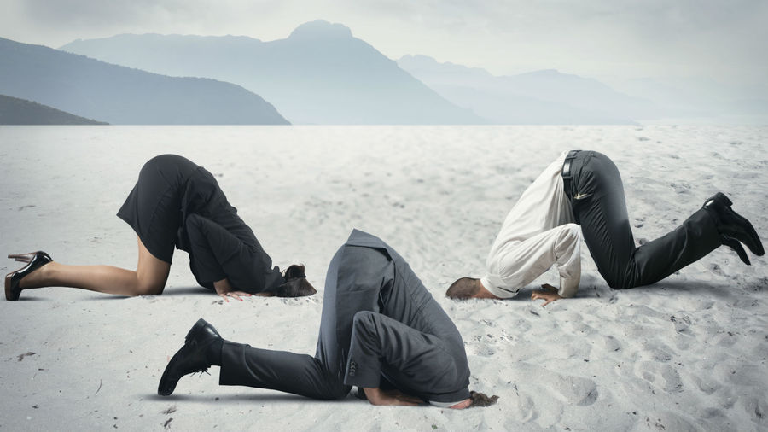

Slide 33
Where IDEA (all Federal Programs) is Going
Student Results

Slide 34
Shift the Balance
Student Learning Outcomes
Procedural Compliance

Slide 35
Shift the Balance
Student Learning Outcomes
Procedural Compliance

Slide 36
OSEP’s Purpose with Results Driven Accountability
Increasing Emphasis of Monitoring & Reporting Requirements toward:
Determining whether Services to Children w/Disabilities are Effective in Improving the Educational & Functional Outcomes for Students,
+
While still Maintaining most of the Compliance Requirements

Slide 37
Remember This? Procedural Compliance Only
Not in 2014-15, or Ever Again
Data Source: OSEP

Slide 38
Vision for RDA
All components of an accountability system will be aligned in a manner that best support States in improving results for infants, toddlers, children and youth with disabilities, and their families.
Adapted from OSEP presentation

Slide 39
Results Driven Accountability
State Status Determinations are Different Now

Slide 40
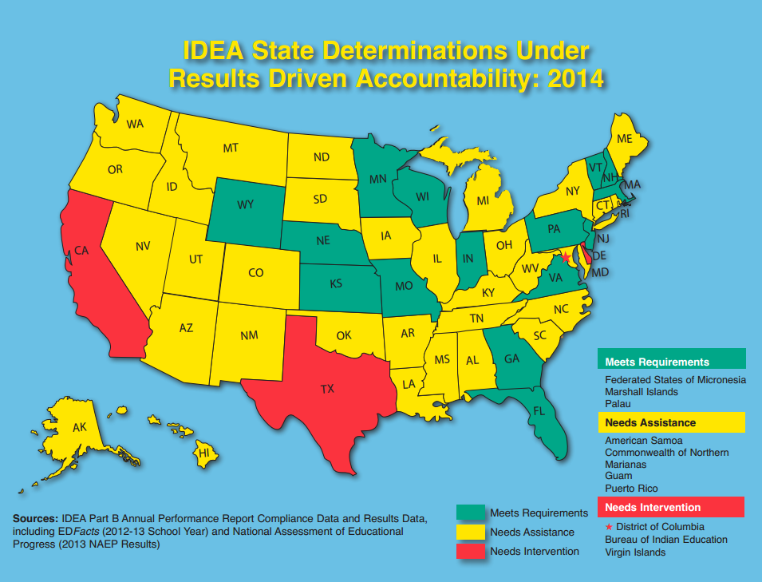
Procedural Compliance + Results
Data Source: OSEP

Slide 41
2014 Rubric Scores
Virginia | 95.0%
Wyoming | 92.73%
Kansas | 92.5%
Indiana | 90.45%
New Jersey | 90.23%
New Hampshire | 90.0%
Florida | 87.95%
Massachusetts | 85.23%
Pennsylvania | 85.23%
Wisconsin | 85.0%
Minnesota | 82.95%
Missouri | 80.68%
Vermont | 80.45%
Georgia | 80.00%
Nebraska | 80.0%
Adapted from VA DoE presentation

Slide 42
Shift Happens !

Slide 43
Any Questions So Far ?

Slide 44
How does RDA Affect You ? What Impact ?
Preparing for What You Can Do

Slide 45
In Thinking about Your District
1. What Challenges do You See in Addressing RDA?

Slide 46
Critical Points
Performance on Procedural Compliance in the past Several Years
Performance on Results Measures in the past Several Years
State’s SIMR & Your Performance
Capacity to Support Staff in Improving Results
Sustaining Procedural Compliance while Improving Results

Slide 47
Changes That Have Happened
State Level Applications

Slide 48
Revisions to Your State’s SPP & APR
The Revisions Guided by 3 Principles –
Aligned with the Principles of RDA, i.e., focus on what will most likely to impact improved educational results & functional outcomes
Unspoken Premise is…
Adapted from OSEP presentation

Slide 49
Revisions to SPR & APR
Reduced Reporting Burden Only require Information Prescribed by Statute & Regulation, or Directly linked to Improved Educational Results & Functional Outcomes
Maintaining Data Sources & Measures Only Absolutely Needed for Reporting
Unspoken Premise is…
Adapted from OSEP presentation

Slide 50
Revisions by OSEP for RDA include
Focus on 3 Results Indicators:
Indicator #B1: Graduation Rates
#B3: Assessment
#B14: Post Secondary Outcomes
Attend to New Indicator:
#17: State Systemic Improvement Plan (SSIP)
S
S
I
P
Adapted from OSEP presentation

Slide 51
Notes:
Intersting Facts About the Leaning Tower of Pisa
The leaning tower of Pisa weighs 14,500 tonnes - Although it took quite a long time for construction to be completed, the official estimated weight of the tower is just shy of 14,500 tonnes. No wonder the clay foundation couldn't handle the weight!
The tower took over 800 years to completely finish - With the final modifications to the tower made in the early 21 st century, the entire process took over 800 years. During this time it witness two great wars, civil war, change in religious governments, and a change in use. It was "completed" in 1350 (over 200 years after its initial construction), but has undergone constant additions and modifications since that date.
The leaning tower of Pisa is only 55.86 meters tall - With its low height, it's the smallest "tower" achieve worldwide recognition.
Europe 's most famous monument was the result of a slight miscalculation -Although many factors have contributed to the lean, the decision of where to build the tower resulted in the original tilt of the tower.
It is a symbol of national pride - What is the first thing that comes to mind when you hear the word Pisa ?
It is located in the Piazza Dei Miracoli - The "field of miracles" is where the tower is located, along with a few other famous structures, such as the Duomo, the Camposanto, and the Baptistery.
It was upright for five years upon completion of its initial construction - Having only two floors, no one was aware of any problem with the tower. Upon the addition of the third floor the tower began to lean, and the result was thousands of confused people and hundreds of years of quick-fixes.
Construction was halted for 100 years - Once the tower began to lean the construction was halted for 100 years. During this time, engineers hopes that the clay beneath the tower would settle and harden enough to permit further construction.
A new architect resume construction - Giovanni di Simone continued where the tower had left off, adding four additional floors to the tower. Fortunately, and despite his efforts, he was unable to correct the lean.
A bad idea made the lean worse - Alessandro Della Gherardesca tried to show the world the intricately decorated base of the tower by digging a walkway around the base. You can imagine the resulting disaster when his workers struck water, flooding the ditches.
Mussolini tried to fix the tower - Embarrassed of the tower, and calling it a disgrace to national pride, he attempted to fix the tower by way of a cement counterweight drilled into the base of the tower. It didn't work.
The tower has 294 steps - How fast can you make it up?
The tower was almost torn down - American soldiers, under the orders to destroy all buildings that may act as a potential nest for enemy snipers, nearly destroyed the famous tower during World War Two.

Slide 52
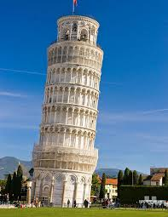
State Systemic Improvement Plan (SSIP)
Comprehensive, Multi-Year Plan for Improving Results for Students, includes 3 Phases:
Phase 1: FFY 2013-14 (Reported in April, 2015)
Data Analysis
Identify SIMR
Analyze Infrastructure to Support Improvement & Build Capacity
Theory of Action (If-Then)
Adapted from OSEP presentation

Slide 53
Initiate Data Analysis
Conduct broad Infrastructure Analysis
Identify problem area
Root Cause Analysis (inc. infrastructure) ID factors
For each factor, ID barriers & leverage points for improvement
What is the Problem ?
Why is this Happening ?
SSIP Phase 1
SSIP Phases 1 & 2
SSIP
SSIP Phase 3
How Well is the Solution Working?
SSIP Phases 1 & 2
What shall we do about it?
Implement Over Time
Search/evaluate evidence- based solutions
Evaluation of progress annually
Adjust plan as needed
Develop Action Steps
Develop Theory of Action
Develop Plan for Improvement
Adapted from OSEP presentation

Slide 54
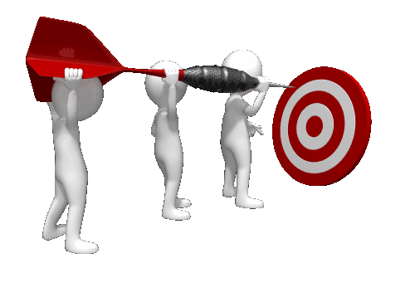
Data Analysis
Broad,
Quantitative, &
Qualitative
What are the Problems (Opportunities)?
Infrastructure Analysis
Broad, Quantitative, &
Qualitative
SIMR - A Focus for Improvement
What’s a Pivotal Problem?
In-Depth Data Analysis
In Depth Infrastructure Analysis
Theory of Action
‘Why’ We Will Do What We Do

Slide 55
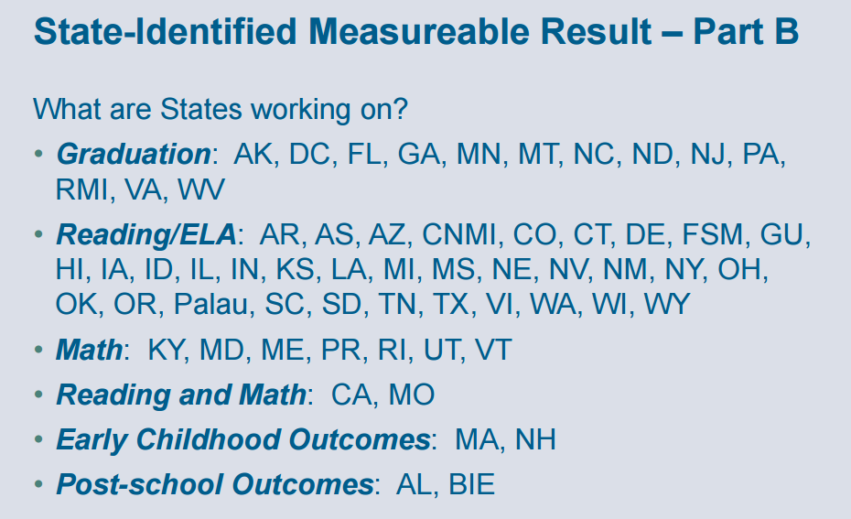
Limited = 31 states
Broad = 25 states
??? = 3 states

Slide 57
Any Questions So Far

Slide 60
Infrastructure – What Does it Look Like ?
Structure & Processes
Student Learning
How do you assess/evaluate?

Slide 62
Intro to BSCPC tool
BSCPC Presentation, 2015 Albuquerque

Slide 63
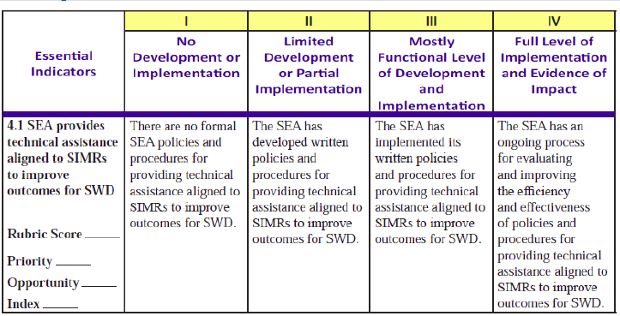
BSCPC Presentation, 2015 Albuquerque

Slide 64
Source: Kavulic, 2015 – Albuquerque Institute

Slide 65
Source: Kavulic, 2015 – Albuquerque Institute

Slide 66
Source: Kavulic, 2015 – Albuquerque Institute

Slide 67
Source: Kavulic, 2015 – Albuquerque Institute

Slide 68
Source: Kavulic, 2015 – Albuquerque Institute

Slide 69
Indicator 17: SSIP
Note: This is a State Plan – Not an LEA Plan
Phase 2: FFY 2014-15 (Reported in February, 2016)
Infrastructure Development
Support Local Agency Implementation of Evidenced-Based Practices
Evaluation Plan
Phase 3: FFY 2015-16, 16-17, 17-18, 18-19
Results of Ongoing Evaluation & Revisions to SPP/APR
Adapted from OSEP presentation

Slide 70
X 2
Source: Kavulic, 2015 – Albuquerque Institute
Notes:
https://custom.cvent.com/8A7E982955054317AE5532B53D2CB647/files/9fd7cc18cdb14d7a9d2e6c082d2dac10.pdf

Slide 71
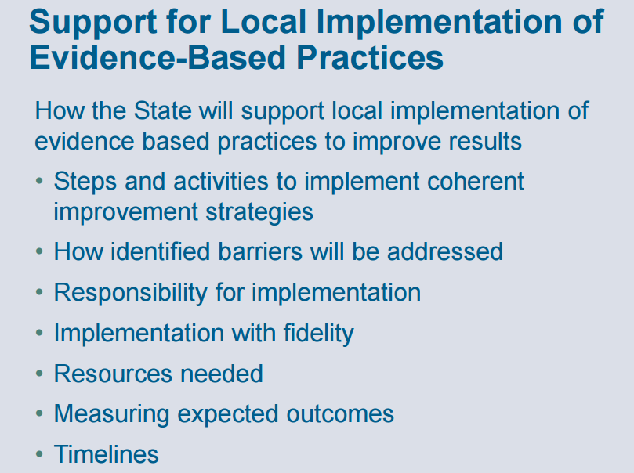
Source: Kavulic, 2015 – Albuquerque Institute

Slide 72
Source: Kavulic, 2015 – Albuquerque Institute

Slide 73
Source: Kavulic, 2015 – Albuquerque Institute

Slide 74
Phase 1 Submitted on Time
But - Deadline Passed

Slide 75
2014-15
2015-16
2016-17
2017-18
2018-19
SDE Infrastruc-ture Develop-ment
?
?
?
?
SIMR - A Focus for Improvement
Support LEA Implement-ation of Evidence-Based Practices
?
?
?
?
Evaluation Plan ?
Adapted from OSEP presentation

Slide 76
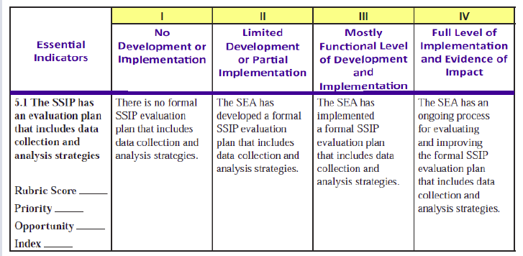
BSCPC Presentation, 2015 Albuquerque

Slide 77
How is My State Education Agency Internally Aligned to Implement RDA?

Slide 78
How does RDA Affect You ? What Impact ?
Preparing for What You Can Do

Slide 79
In Thinking about Your District
1. What Challenges do You See in Addressing RDA?

Slide 80
Critical Points
Performance on Procedural Compliance in the past Several Years
Performance on Results Measures in the past Several Years
State’s SIMR & Your Performance
Capacity to Support Staff in Improving Results
Sustaining Procedural Compliance while Improving Results

Slide 81
In Thinking about Your District
2. What Resources do You Need in Addressing RDA?

Slide 82
Critical Points
Resources You have Now to Emphasize Improving Results
Identified Needs of Staff
Data Sources to Measure and Visualize performance
State’s Commitment to Continuing Professional Learning
Costs to Sustain Gains Realized in Next few Years

Slide 83
In Thinking about Your District
3. What are the Public/Political Implications in Your Community for RDA?

Slide 84
Critical Points
State’s Process to Determine LEA Status Determinations?
State’s Process for Disseminating this Information to the Public, if at all?
Current Local Stakeholder Involvement in Efforts to Improve Results
Current Attitudes Towards Special Education

Slide 85
In Thinking about Your District
What are Opportunities & Accomplishments in your District on which You Can Build for Students w/ Disabilities?

Slide 86
Did We Cover What Was Promised ?
Well, Let’s Review

Slide 87
3 Sections for this Morning
Context – How We Got to this Point in Special Education
Results Driven Accountability – A Shift in Emphasis
Preparing for Impact - What You Can Do

Slide 88
Do We Have Time?

Slide 89
Impact is Coming !

Slide 90
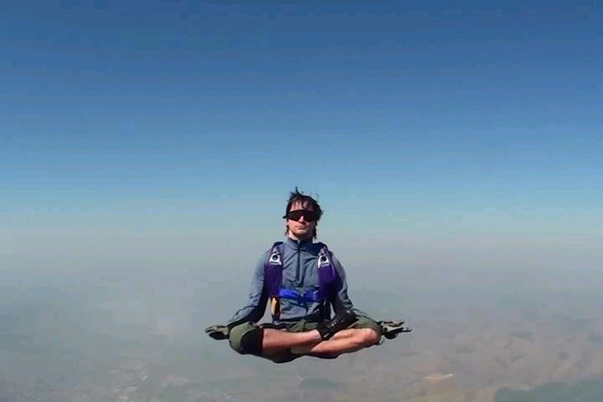
Somewhere Over Your State

Slide 91
It’s Been a Pleasure
See You in Future with Better Results

Slide 92
How to Contact Alan?
W. Alan Coulter, Ph.D. acoulter@lsuhsc.edu

