Slide 1
systems thinking: an Introduction
Jo Brown
Deaf Education Services coordinator / Educational Interpreter
St. Tammany Parish Schools

Slide 2
Today’s Focus
Understanding systems thinking, why it is important
Basic system thinking principles and tools
Share examples of systems thinking in action
Look at how system thinking can apply to your own work
How you can become a system thinker
Notes:
Understanding systems thinking, why it is important
Basic system thinking principles and tools
Share examples of systems thinking in action
Look at how system thinking can apply to your own work
How you can become a system thinker

Slide 3

Frustration
No one knows what we do or understands why we do it.
No one understands our role.
There is no one to talk to that understands.
We are not sure where or if we fit in.
We are often thought of as “Rude” , dethatched, aloof. ( Dr. Johnson & A. Witter- Merithew )
It’s what we were taught!!!
  Invisible, non – intrusive
Notes:
So why should interpreters learn about Systems Thinking ?
Book- Towards Competent Practice, Conversation With Stakeholders ( Deaf and Hearing consumers were asked )

Slide 4
Systems thinking offers us
A way to think about what we do
A way to approach our work
A less interpreter centric view of our work – see the big picture
A understanding of how organizations, agency's and institutions function
A clearer scope of how interpreters/staff can fit in
A way to foster relationship – with all
A way to view an interpreter as a co- participant

Slide 5
“Stop looking for who’s to blame; instead start asking,
what’s the system?”
~Donella Meadows

Slide 6
A system is a collection of parts integrated to accomplish an overall goal.
Systems range from very simple to very complex
System
Notes:
So….what is a system?

Slide 7


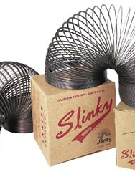
Simple Systems
Notes:
A bicycle , s slinky, a small busy – with one owner – one or a few employees

Slide 8
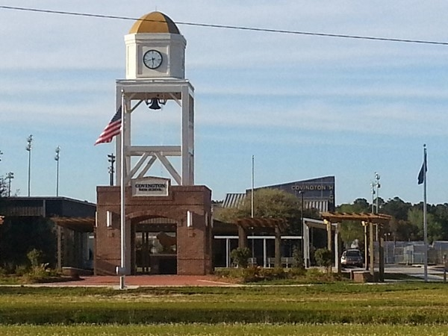
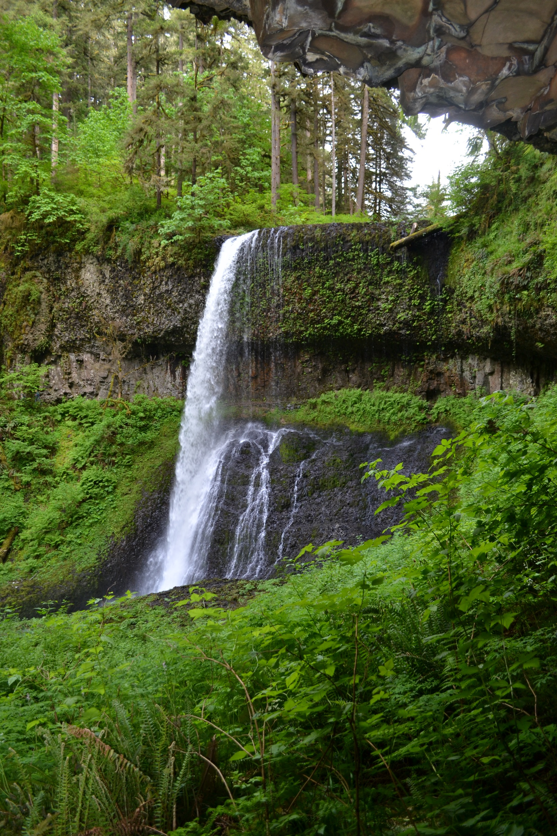
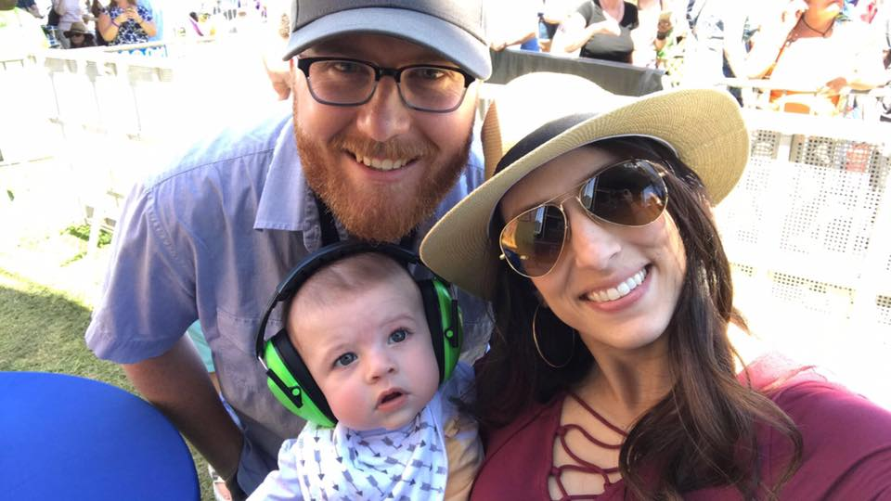
Complex Systems
Notes:
An eco system, a family, a public institution – a school, a court of law, a hospital etc

Slide 9
system Characteristics
Every system has a purpose within a larger system
All of a system's parts must be present for the system to carry out its purpose optimally.
A system's parts must be arranged in a specific way for the system to carry out its purpose.
Systems change in response to feedback.
Systems maintain their stability by making adjustments based on feedback
Notes:
on a bike is the chain is missing – the bike can not provide transportation, exercise etc. if one
In a family unit when a family member has a baby many elements of the family change
In an ecosystem if a company comes in and cuts down trees. – that area will change, animals my die, plants my die etc. Most often adjustments will be made, more ground cover will grow, different animals will come etc.
As interpreter we are a single part of the system which we are working in ….dr appt,…in the court for that one day…..sub interp in a class . But even though we may be there for a short time that assignment is tied to something bigger then just that hour or two It’s tied to prior events …appointments, lessons, continuing building vocabulary
.
What we do in the time we are there has impact on that system.

Slide 10
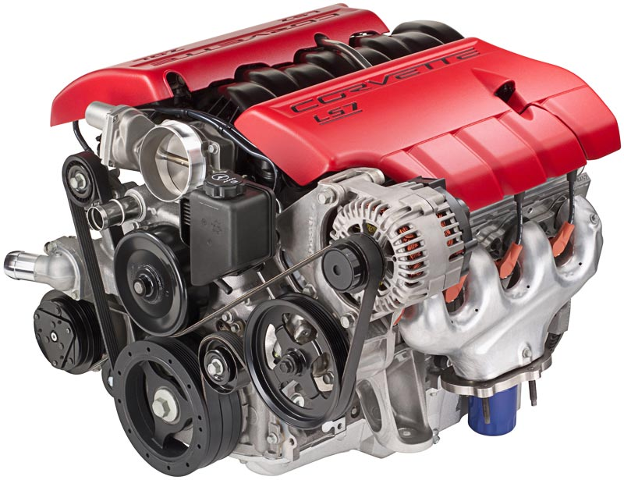
System Design
Notes:
What is this?
A motor is very important part of a car, the car can’t move without it – car can’t run with out it.
Do you think when a car was designed by parts – or by the whole
We have to think of the whole not the parts. We have to think of system as a design – what does the whole picture look like.

Slide 11
Systems
Thinking
Systems thinking is a way of helping a person view systems from abroad perspective that includes seeing overall structures, patterns and cycles in systems, rather than seeing only specific events in the system.

Slide 12


Slide 13

systems where interpreters work
Human Systems
Relationships
People
Knowledge
Healthcare
Education
Social Services
Legal
Video Relay
Dynamic workforce -
Structures
Funding
Leadership &
Governance
Processes
Notes:
Human System – socio- political in nature – serves the interests of society and has negotiated standards, government regulated, is related to social relationships and involves authority or power
Relationships – the people - which involve issues of power and authority ex. Dr. nurse, x ray tech , School teacher, principle Understanding their jobs can help you make decisions.
Knowledge – what is need to know for that assignment in that environment
DYNAMIC WORKFORCE – Structures is a manifestation of a group of like-minded people, stalwarts in their own respective field to come together with a common objective to be a significant player in the arena of Human capital development. How communication follow from one area to another, asking questions about a procedure. Collecting data – paper work, forms. This paper work become a record – employee may change but the paper follows the person. ( sight translations – prep with forms that maybe used)
Leadership & Gov – Processes - systems have to follow procedures and polices and standards
Funding - who pays you, what P. L. are followed
Often we want these systems to change because we are there. And yes, with the inclusion of Deaf individuals and sign language interpreters the way of communicating will change from what usually happens in that environment. We are effected by the systems much more they we effect them
We often want the system to adapt to us. So… to have better collaboration with those we work with. We need to understand the system and try to fit into the system more naturally
It’s equally important for us to understand the system as it is for the system to understand us. - we are a small part of that system
Demand Control Scheme is a great tool to use in making these decisions.

Slide 14
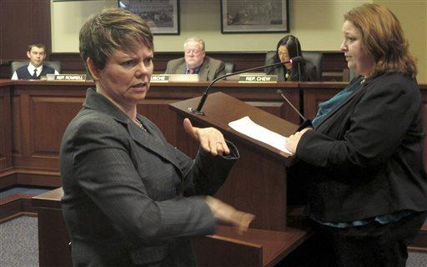


SYSTEMS WHERE INTERPRETERS WORK
Notes:
To practice
Education – what personal is involved. Who is involved that is not in the classroom but still affect your work. What happened, yesterday, last month, what your doing today how does that relate to what is done tomorrow. How does this classroom fit into the structure of education. If the student goes to a resource room – how does that change or effect the system. What about the curriculum, state standards etc. How can you fit in more effectively with the goals of this system
Medical – Deaf patient the personal, the structures that exist the process,
Legal - your interpreting in a primary hearing you’re interpreting for the plaintive . What is happening now – relate to ____ Process used, Help to see how other people in the system work together.

Slide 15

to create change ….

Slide 16
Types of Thinking
Conventional
Works for immediate simple problems
Systems
Needed for chronic complex problem
Notes:
Conventional
Works for immediate simple problems
You kid get a cut, you put a bandage on it
Systems
Needed for chronic complex problems
Your kid come home from school with cuts about three days a week – somethings going on…..

Slide 17



Systemic Problems in the News
Notes:
Opioid Epidemic – deaths continue to increase. US has tried to make opioids less accessible — by, for example, pushing doctors to prescribe fewer pills – it’s not working – that a failure of our system – that Conventional thinking . This epidemic will not iimprove without changing the system.
World Hunger – delivery food to a ________country is a bandage which in the long run will make these people more dependent on others. Using system thinking and looking at the big picture – what can allow these people to be more independent .
This is a picture taken in N.O. Of homeless people living under the interstate. I recently read an article about a local church who __________________________

Slide 18
Common Characteristics of Failed Solutions
Usually succeed in the short run
Negative consequences are unintentional
We do not see the problem as our responsibility
Short- term gains create long- term impacts
( negative )

Slide 19
Systemic Problems in Interpreting
Notes:
Where has the system failed?
What needs to change within the system to fix these long term – chronic problems?

Slide 20
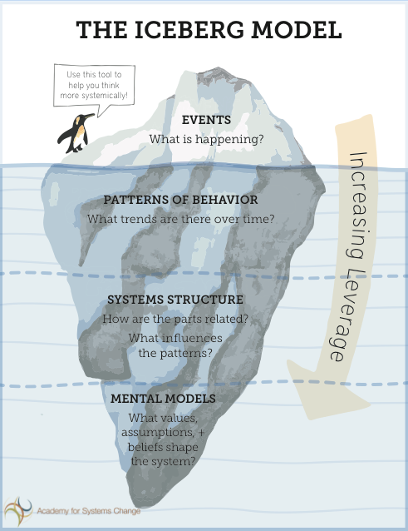
Deepening Our Understanding of Problems: The Iceberg Model
React
Anticipate
Design
Transform
Notes:
This model helps us see not simple what is happening ( the event) but also the underling reason why it happened
Events – things that make us react. Ex. Going to work everyday, waking up every morning at 7 am, interpreting science class
We want to make sure it’s a systemic issue before we spend time and energy on trying to figure it out
Events may sometimes be a one off event – in this case you don’t need to look or intervein at it using a S T lens.
Patterns- may be waking up late every Friday, struggling to interpret for science class – everyday
Patterns are important because they let us know if something + or – is happening
Understanding patterns helps us anticipate that may be going to happen based on past behaviors
Systems Structure – this is the scaffolding of the system – can be formal > policies, procedures, process etc. or informal - things that people in the system do > the short cuts they do to get the work done.
Structures – enable the patterns to exist.
At this level we can intervene at a design level – by understanding how the system that exists has been designed and way that we can alter the design to get the desired results.
Mental Models – attitudes, biases, beliefs and assumptions of the people who designed the system. Also of the people working with in the system who have created the patterns which we now want to address
Working are this level allows us to make significant transformations – with the people working in the system and in the system it’s self.

Slide 21
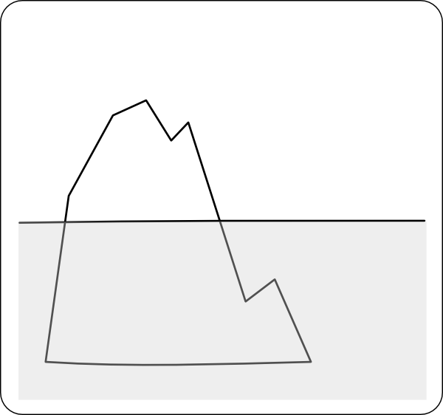
Notes:
Recently a TOD called me complaining that she was in the students mainstream classroom to ask the interpreter a question… the bell rang and the interpreter was not there – she was about 10 mins late - so the student missed the first 10 mins of class. Did this happen often? Was it on going? Was she late for all her classes? Was this a one time event or a conic problem?
So before approach the interpreter about it, I ask the other teachers how it was working out with an interpreter in the room. None of them said she was late.
So the next week I went to this class and again the interpreter was late. I felt sure there was a reason for this so I insured the interpreter that I made sure the student go all the classroom info before she arrived.
So after class I walked with the interpret to her next class ….
She explained that she has lunch duty every Friday and rushes to eat and use the restroom before class.
What sort of problem is this??
All staff has to have duty?
Why didn’t the interpreter let me or TOD know etc.

Slide 22
Notes:
chronic complex problems in interpreting
If you want to change the patterns which are happening you MUST change the mental models - the beliefs and biases
Ex. Of systemic problem in Educational Interpreter field. Interpreters are under the para umbrella and not view as professional – related services
Patterns - pay, benefits, job title confusion etc.
Design – lack of knowledge about role, etc. Won’t change unless mental models are changed
Mental Models - if they don’t know about Deafness, Interpreting process etc. they don’t realize what all in involved with the jobe

Slide 23
start thinking
It’s not only about what we’re doing, it’s about what everyone is doing
We often explain what we don’t do but we don’t explain what we do, do
Be mindful that different people have different points of view
It takes time to make systemic changes – years
Have to give up short term benefits
I am part of the problem
System Thinking = Collective Intelligence
Notes:
We seek to understand how our job in the system works together with other parts of the system

Slide 24
A System’s thinker….
Looks at the BIG PICTURE
Talks about ideas and ask for others input
Looks at other peoples perspectives – how they may see it
Thinks about change over time – not just what’s happening in the moment
Looks for ways to improve the system and doesn’t blame
Research's what is important to the system – the keys of it
Considers how their thinking affects the system – the effect of their actions
Checks their results and changes their work/decisions if needed
Is patient when things become complicated or confusing

Slide 25
Take Away
With Systems Thinking we can be more effective in managing our responses and less reactional.
With System Thinking we can understand why somethings happening – we understand it source.

Slide 26
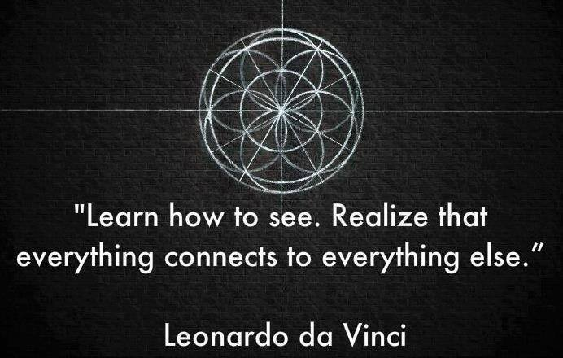

Slide 27
Resources
Articles, Papers, and Blogs
David Peter Stroh, “Leveraging Grant-making: Parts 1 and 2,” The Foundation Review, 2009 Vol. 1:3 and 2010 Vol. 1:4; cof13.foundationreview.org
Articles applying a systems approach to social issues, e.g. homelessness, urban crime, economic crisis, identity-based conflicts: http://www.bridgewaypartners.com/OurPublications/Articles/ SocialChange.aspx.
Books
The Fifth Discipline, Peter Senge • The Fifth Discipline Fieldbook, Peter Senge et al • Thinking in Systems, Donnella Meadows
Systems Thinking for Curious Managers, Russell L. Ackoff

Slide 28



Slide 29
Mission
The National Association of Interpreters in Education, NAIE, is an organization of interpreters who provide services to support the communication needs of students in educational settings. NAIE promotes the pursuit of professional excellence regarding interpreting services in these settings.
Notes:
Pat Himes: Mission and purpose
Purpose of NAIE will be to identify and support best practices within the field, advocate for its members, provide continuing education, networking, resources and other professional opportunities.

Slide 30
Membership
Our goal is to support and advocate for interpreters who work in educational settings by encouraging unity toward maintaining and promoting high standards of practice. You can support us in this venture by becoming a member of NAIE.
Your membership can help drive fundraising, partnerships, scholarships, and increase awareness on professional ethics and standards.
Notes:
Jo talk about membership

Slide 31
Publications
Quarterly Newsletter
  “Tool of the Month”
Handbook and Guidebooks
Notes:
Jo talk about membership

Slide 32
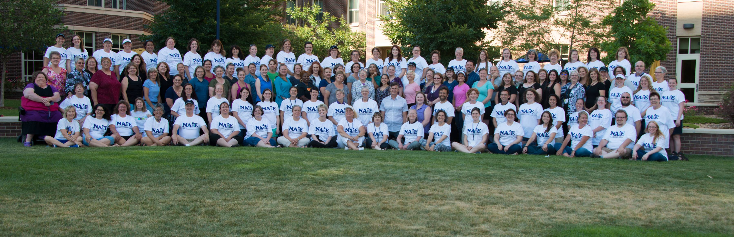
Professional Development
Webinars
Conferences
Notes:
Webinars
3 a year - free with membership
Conferences
Every other year
Trainings - 3 or 4 different parts of the country
On none conference year

Slide 33


Communications
www.naiedu.org
MemberPlanet
Social Media (Facebook/Twitter)
Notes:
Jo talk about membership

Slide 34
Contact Us
Membership Secretary - membership@naiedu.org
MAL Publications - publications@naiedu.org
MAL Communications - webmaster@naiedu.org
MAL Governance - memberatlarge@naiedu.org
President - president@naiedu.org
Vice President - vicepresident@naiedu.org
Treasurer - treasurer@naiedu.org
Secretary - secretary@naiedu.org
Notes:
Tracey talk about contacting us

